Slide 1

Modernizing ActiveGear: A Strategic Shift to Database Management
Leveraging Data to Enhance Operational Efficiency
By: Ryan Talbot
Notes:
Good morning/afternoon, everyone. I'm Ryan Talbot, and today we'll explore how we're not just changing, but revolutionizing ActiveGear with the introduction of a Relational Database Management System—RDBMS. As we transition from a paper-based system, our focus will be on four key areas: improving efficiency, gaining insights into customer behavior, enhancing inventory management, and boosting sales performance. This shift is not just a step but a strategic leap into operational excellence.

Slide 2
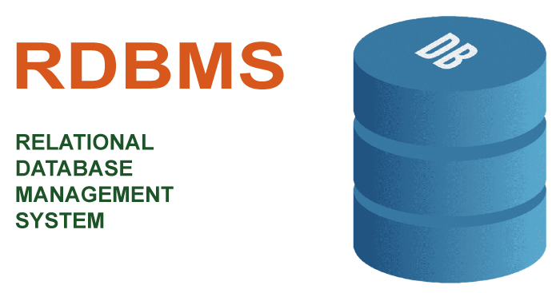
Revolutionizing ActiveGear with RDBMS
Efficiency
Insights into Customer Behavior
Inventory Management
Sales Performance
Data Integrity and Security
Scalability and Flexibility
Cost Savings
Notes:
Moving from a paper-based system to a Relational Database Management System (RDBMS) offers numerous benefits across various aspects of business operations:
1. **Efficiency**:
- RDBMS allows for faster data entry, retrieval, and processing compared to manual paper-based systems.
- Tasks like data entry, searching, and updating can be automated, reducing human error and saving time.
2. **Insights into Customer Behavior**:
- With an RDBMS, businesses can store and analyze large volumes of customer data efficiently.
- Analytical tools integrated with the RDBMS can provide insights into customer preferences, buying patterns, and behavior, enabling targeted marketing strategies.
3. **Inventory Management**:
- RDBMS facilitates real-time tracking of inventory levels, stock movement, and reorder points.
- Automated alerts can be set up for low stock levels or impending stockouts, helping businesses maintain optimal inventory levels and avoid stock shortages or excesses.
4. **Sales Performance**:
- RDBMS allows for the integration of sales data from various channels, such as online platforms, POS systems, and offline stores.
- By analyzing sales data stored in the RDBMS, businesses can identify trends, high-performing products, and underperforming areas, enabling informed decision-making to improve sales performance.
5. **Data Integrity and Security**:
- RDBMS offers mechanisms for data validation, ensuring accuracy and consistency of data.
- Access controls and user permissions can be implemented to restrict unauthorized access to sensitive information, enhancing data security.
6. **Scalability and Flexibility**:
- RDBMS can scale up to accommodate growing data volumes and business needs without significant changes to the underlying infrastructure.
- The relational model allows for flexible querying and reporting, empowering businesses to derive valuable insights from their data.
7. **Cost Savings**:
- While there are initial setup costs associated with implementing an RDBMS, the long-term savings from improved efficiency, reduced paperwork, and better decision-making can outweigh these costs.
- Additionally, RDBMS reduces the need for physical storage space required for paper documents, leading to cost savings in terms of office space and document management.
Overall, transitioning from a paper-based system to an RDBMS offers businesses the opportunity to streamline operations, gain deeper insights into their customers and business performance, improve efficiency, and enhance data security and integrity.

Slide 3
Understanding Entities and Their Importance
Stores(StoreID PK, StoreName, Location, Contact)
Employees(EmployeeID PK, SSN, Name, Gender, DoB, Position, Salary, AffiliateStoreID FK, SupervisorID FK)
Transactions(TransactionsID PK, Date, Time, CustomerID FK, TotalAmount, PaymentMethod, StoreID FK)
Product_Transaction(TransactionID FK, ProductID FK, Quantity)
Products(ProductsID PK, Price, Description, ProductName, VendorID FK)
Inventory(StoreID FK, ProductID FK, stockLevel, Quantity)
Vendors(VendorID PK, Address, Contact, VendorName)
VendorProducts(VendorID FK, ProductID FK)
Notes:
Sure, here's a brief explanation of each entity:
1. **Stores**:
- This entity represents the physical stores where transactions take place.
- Attributes include StoreID (primary key), StoreName, Location, and Contact.
2. **Employees**:
- This entity stores information about the employees working within the stores.
- Attributes include EmployeeID (primary key), SSN (Social Security Number), Name, Gender, Date of Birth, Position, Salary, AffiliateStoreID (foreign key referencing Stores), and SupervisorID (foreign key referencing Employees, representing the supervisor of the employee).
3. **Transactions**:
- This entity records information about each transaction made in the stores.
- Attributes include TransactionID (primary key), Date, Time, CustomerID (foreign key referencing Customers), TotalAmount, PaymentMethod, and StoreID (foreign key referencing Stores).
4. **Product_Transaction**:
- This entity represents the many-to-many relationship between Transactions and Products, indicating which products were involved in each transaction and their respective quantities.
- Attributes include TransactionID (foreign key referencing Transactions) and ProductID (foreign key referencing Products), along with Quantity.
5. **Products**:
- This entity stores information about the products available for sale.
- Attributes include ProductID (primary key), Price, Description, ProductName, and VendorID (foreign key referencing Vendors).
6. **Inventory**:
- This entity tracks the inventory levels of products in each store.
- Attributes include StoreID (foreign key referencing Stores), ProductID (foreign key referencing Products), stockLevel, and Quantity.
7. **Vendors**:
- This entity contains information about the vendors who supply products to the stores.
- Attributes include VendorID (primary key), Address, Contact, and VendorName.
8. **VendorProducts**:
- This entity represents the relationship between Vendors and Products, indicating which products are supplied by which vendors.
- Attributes include VendorID (foreign key referencing Vendors) and ProductID (foreign key referencing Products).
These entities collectively model various aspects of a retail business, including stores, employees, transactions, products, inventory, and vendors, enabling efficient management and analysis of data related to sales, inventory, and supplier relationships.

Slide 4
Laying the Foundation with a Relational Model
The relational model
Tables
Primary Keys
Notes:
The relational model is a conceptual framework used in database management systems (DBMS) to organize and structure data. It is based on the principle of representing data in tabular form, with each table consisting of rows and columns. The relational model emphasizes the relationships between data entities, allowing for efficient storage, retrieval, and manipulation of data.
Key features of the relational model include:
1. **Tables**: Tables are the fundamental building blocks of the relational model. Each table represents a distinct entity or concept, such as customers, products, or transactions. Tables consist of rows and columns, where each row represents a specific instance of the entity, and each column represents a specific attribute or characteristic of that entity.
2. **Primary Keys**: Primary keys are unique identifiers for each row in a table. They ensure that each row can be uniquely identified and distinguished from other rows in the table. Primary keys play a crucial role in maintaining data integrity by enforcing entity integrity, which ensures that there are no duplicate or null values in the primary key column.
Here's a brief overview of the tables mentioned in the provided database schema and their primary keys:
1. **Stores**:
- Primary Key: StoreID
2. **Employees**:
- Primary Key: EmployeeID
- Foreign Keys: AffiliateStoreID, SupervisorID
3. **Transactions**:
- Primary Key: TransactionID
- Foreign Key: CustomerID, StoreID
4. **Product_Transaction**:
- Composite Primary Key: (TransactionID, ProductID)
- Foreign Keys: TransactionID, ProductID
5. **Products**:
- Primary Key: ProductID
- Foreign Key: VendorID
6. **Inventory**:
- Composite Primary Key: (StoreID, ProductID)
- Foreign Keys: StoreID, ProductID
7. **Vendors**:
- Primary Key: VendorID
8. **VendorProducts**:
- Composite Primary Key: (VendorID, ProductID)
- Foreign Keys: VendorID, ProductID
In summary, the relational model provides a structured approach to organizing data into tables, with each table having a primary key to uniquely identify its rows. This model ensures data integrity by enforcing rules for uniqueness and relationships between tables, facilitating effective data management and retrieval in database systems.

Slide 5
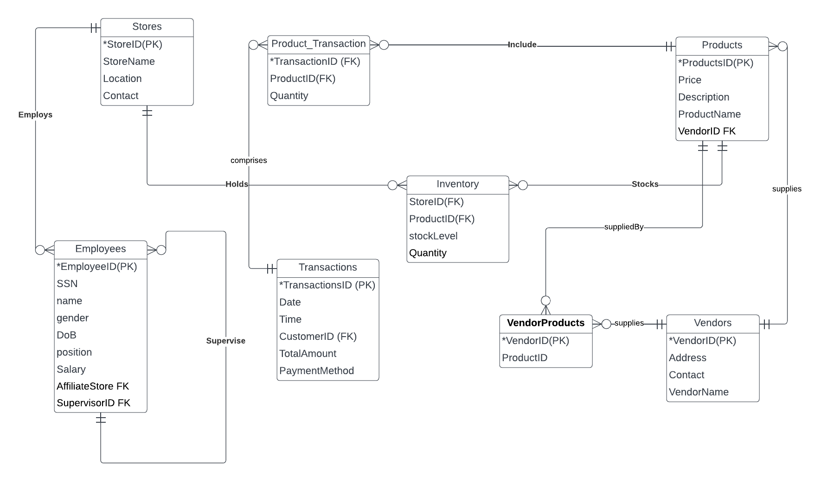
How Our Data Connects
Notes:
"Welcome to our quick tour of the ERD model for our retail management system. This ERD illustrates the database structure that keeps our stores running efficiently.
At the heart of our model, we have 'Stores', where each store is identified by a unique 'StoreID'. Key details such as 'StoreName', 'Location', and 'Contact' information are stored here.
Each store 'Employs' several 'Employees', who are identified by their 'EmployeeID'. The employee's personal details, including 'SSN', 'name', 'gender', 'Date of Birth', and 'position', are recorded, along with their 'Salary', the 'AffiliateStore' they work at, and their 'SupervisorID'.
Moving on, 'Products' are crucial to our business. Each product, identified by 'ProductsID', has a 'Price', 'Description', 'ProductName', and is linked to a 'VendorID'.
Products are linked to 'Transactions' through 'Product_Transaction', which keeps track of the 'Quantity' of products involved in each sale, identified by a 'TransactionID'.
The 'Transactions' table holds vital sales data including the 'Date', 'Time', 'CustomerID', 'TotalAmount', and 'PaymentMethod'.
Our 'Inventory' table keeps track of stock levels for products in each store, with fields for 'StoreID', 'ProductID', 'stockLevel', and 'Quantity'.
Vendors are captured in the 'Vendors' table, each with a unique 'VendorID', and details like 'Address', 'Contact', and 'VendorName'. The relationship between vendors and products is detailed in the 'VendorProducts' table.
Each of these entities interacts within our ERD to create a cohesive, interconnected system that records all aspects of our retail operations, from inventory and transactions to the vendors supplying us and the employees who keep our stores running."
!

Slide 6

Ready for a New Era at ActiveGear
Notes:
In conclusion, the implementation of a Relational Database Management System (RDBMS) marks a significant step forward for ActiveGear's future operations. By transitioning from paper-based systems to an RDBMS, we stand to reap numerous benefits across various aspects of our business, including efficiency gains, enhanced insights into customer behavior, improved inventory management, and better tracking of sales performance.
The RDBMS will streamline our operations, enabling faster data entry, retrieval, and processing compared to manual methods. It will also provide valuable insights into customer preferences, enabling us to tailor our marketing strategies and improve customer satisfaction. Additionally, the RDBMS will empower us to optimize our inventory levels, minimize stockouts, and maximize sales performance through informed decision-making.
As we embark on this journey towards digital transformation, it's crucial that everyone within ActiveGear understands the positive impacts that the RDBMS will bring to our organization. I encourage everyone to provide feedback and ask questions to ensure clarity and alignment as we move forward with these changes. Together, we can leverage the power of the RDBMS to drive innovation, efficiency, and growth for ActiveGear in the years to come.

